Slide 1
QUALITY INFRASTRUCTURE AND STANDARDS: Promoting export competitiveness through GI certification schemes
P108 - KNOWLEDGE SHARING ON TRADE AND INVESTMENT “GOOD PRACTICES II”
ACP House, Brussels, Belgium
05 February 2020
Lidon Charles
Project Coordinator/ Foreign Service Officer III
Foreign Trade Department

Slide 2
Structure of Presentation:
1. Overview of Geographical Indications in CARIFORUM
2. Methodology for identifying local quality origin products
3. Promoting export competitiveness through GIs
4. Integration of GIs into Market Access Strategies
5. Capacity Building requirements for strengthening competitiveness
6. Conclusion

Slide 3
1. Overview of Geographical Indications in CARIFORUM
Geographical Indications (GI) identify a product as originating in a territory, region or locality in that territory, where a given quality, reputation or other characteristic of the good is essentially attributable to its geographical origin. See Article 22 of TRIPS
Legal tool: IP right
Differentiation & development tool
GI AS A MULTIPLE TOOL
Economic & marketing tool
Political tool

Slide 4
1. Overview of Geographical Indications in CARIFORUM
CARIFORUM – EU Economic Partnership Agreement between the EU and the 16 States of CARIFORUM requires the recognition and protection of GIs in all State Parties. Eleven CARIFORUM States have legislation specific to GIs. Belize is in the process of developing legislation. The Dominican Republic, Suriname, Haiti and Grenada do not have specific GI legislation.
Geographical Indications | Country of Origin
Mangos Dominicanos | Dominican Republic
Cacao Dominicanos | Dominican Republic
Café Barahona | Dominican Republic
Café Valdesia | Dominican Republic
Café Juncalito | Dominican Republic
El Ramonal | Dominican Republic
Los Bejucos | Dominican Republic
Cigarro Dominicano | Dominican Republic
Geographical Indications | Country of Origin
Oro Verde Cambita | Dominican Republic
Demerara Rum | Guyana
Demerara Sugar | Guyana
Demerara Molasses | Guyana
Blue Mountain Coffee | Jamaica
Jamaica Jerk | Jamaica
Jamaica Rum | Jamaica
Montserrat Hills Cocoa | Trinidad and Tobago

Slide 5
1. Overview of Geographical Indications in CARIFORUM
In 2016, the ACP-EU TBT Programme funded a project aimed at:
Enhancing knowledge amongst the public and private sectors on the WTO SPS and TBT Agreements, the TRIPS Agreement, the EU Agricultural Quality Schemes and the opportunities these legal instruments provide to enhance market access for food products in the regional Caribbean and global markets to the benefit of farmers, producers and consumers.
This project successfully saw the identification, application and registration of technical specifications for Demerara Rum, Demerara Molasses and Demerara Sugar.
Identified a list of 35 indigenous/traditional products for possible GI development.

Slide 6
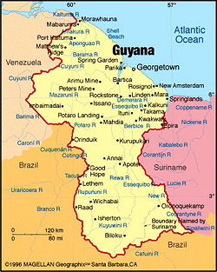
1. Overview of Geographical Indications in CARIFORUM
In 2019 a project was initiated under the EU TradeCom II Programme – Strengthening Trade Facilitation and competitiveness.
Purpose 1 - SVG: National Trade and Investment Export Strategy and Implementation Plan
Purpose 2 - Guyana: Improve export competitiveness through GI Certification Schemes for quality products
The deliverables of the project are:
Result 2.1: Three (3) to Five (5) quality origin products to benefit from certification as Geographical Indications are identified and confirmed;
Result 2.2: Preparation of Standards and technical specifications for these three(3) to five (5) quality origin products and the registration process initiated;
Result 2.3: Preparation for market access guidelines for three(3) to five (5) quality origin products.

Slide 7
2. Methodology for identifying local quality origin products
Assessing GI eligibility of local products in Guyana: What to look for?
A PRODUCT: With special characteristics, quality and reputation
A TRACEABILITY SYSTEM AND CONTROL PLAN: Essential for the GI sustainability
A MARKET SCENARIO: With an existing reputation on the product and the potential to increase market opportunities
AN ORIGIN: Where the product is originated and which directly impacts on the uniqueness of the product
A SUPPLY VALUE CHAIN: Including upstream (producers and processors), downstream (distributors, traders, exporters, etc.) and other stakeholders (public authorities, agencies, NGOs, associations, other economic activities, etc.)
A MANAGEMENT BODY: KEY PART of the GI system

Slide 8
2. Methodology for identifying local quality origin products
Structure of Technical Specifications:
The Geographical Indication for which registration is sought (i.e. name of product)
Description of Product
Concise Definition of the geographical area
Evidence that the product originates in the defined geographical area
Description of the method of obtaining product (until the final product)
Link between the Product and its geographical area
Control Authority
Any specific labelling rule for the product in question

Slide 9
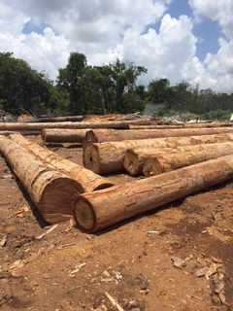
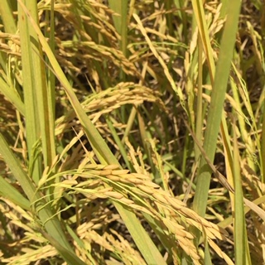
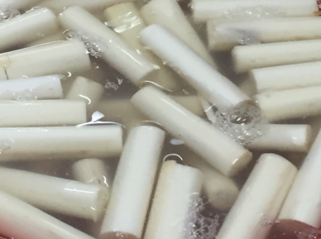
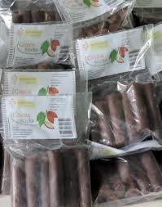
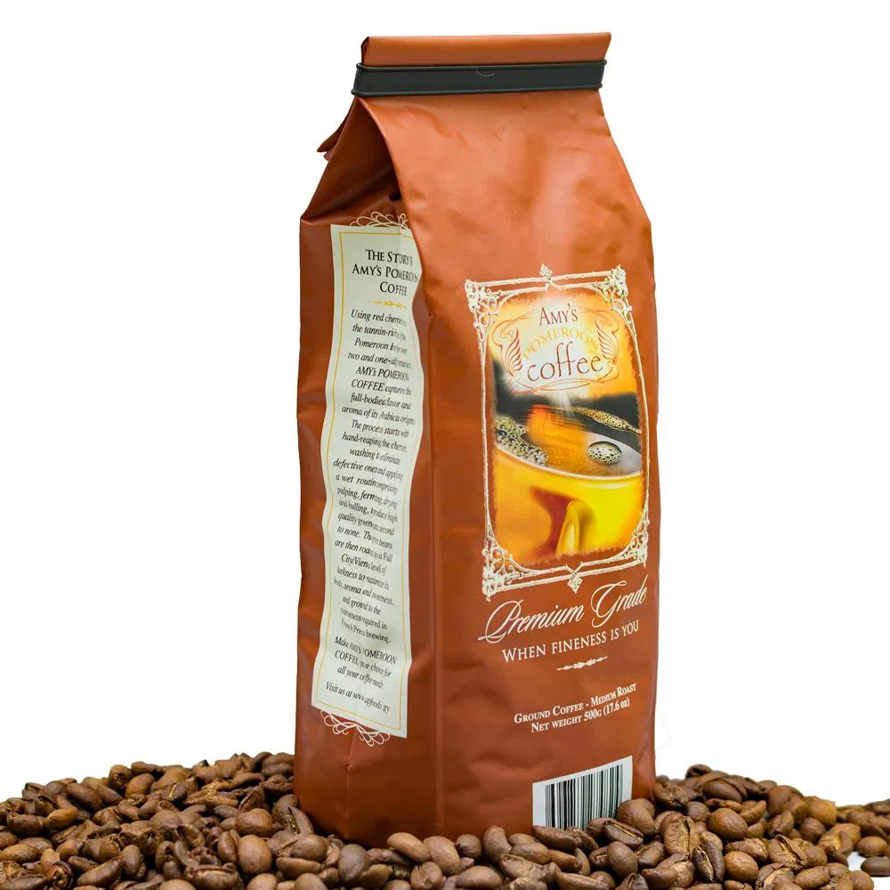
2. Methodology for identifying local quality origin products
Where do we stand?
3 PRODUCTS SELECTED FOR THE DEVELOPMENT OF TECHNICAL SPECIFICATIONS
Requires collectivization of producers, awareness activities,
development of traceability and control system
Guyana
Greenheart
Guyana
Heart of Palm
Guyana Rice
Hosororo
Cocoa
Pomeroon
Coffee

Slide 10
Lessons learnt
Must be a consultative process involving public and private sector stakeholders.
Important to secure buy-in from the private sector since they commercialise the products.
It was necessary to include all stakeholders along the product value chain.
Fair participation: dialogue, discussion, share & common decisions, costs, benefits.
It will be necessary to bring together diverse producers to form a GI Management Body and for them to agree on minimum standards.
Long-term commitment open to all: development, protection, promotion
Awareness raising must occur at every step since most are unfamiliar with GIs.
Regular consultations with the GI Registry, the GI Management Body and National Bureau of Standards throughout the process to keep all apprised and their build capacity to effectively function.
Systems must be implemented for quality control and inspections.

Slide 11
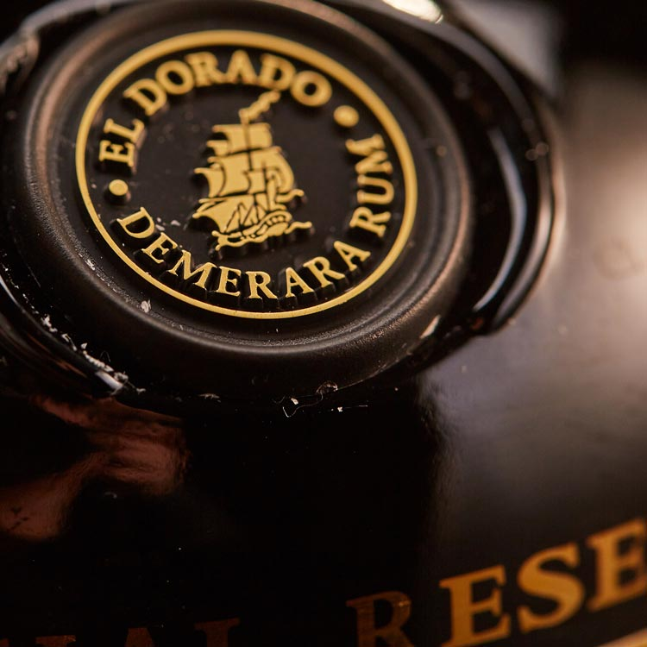
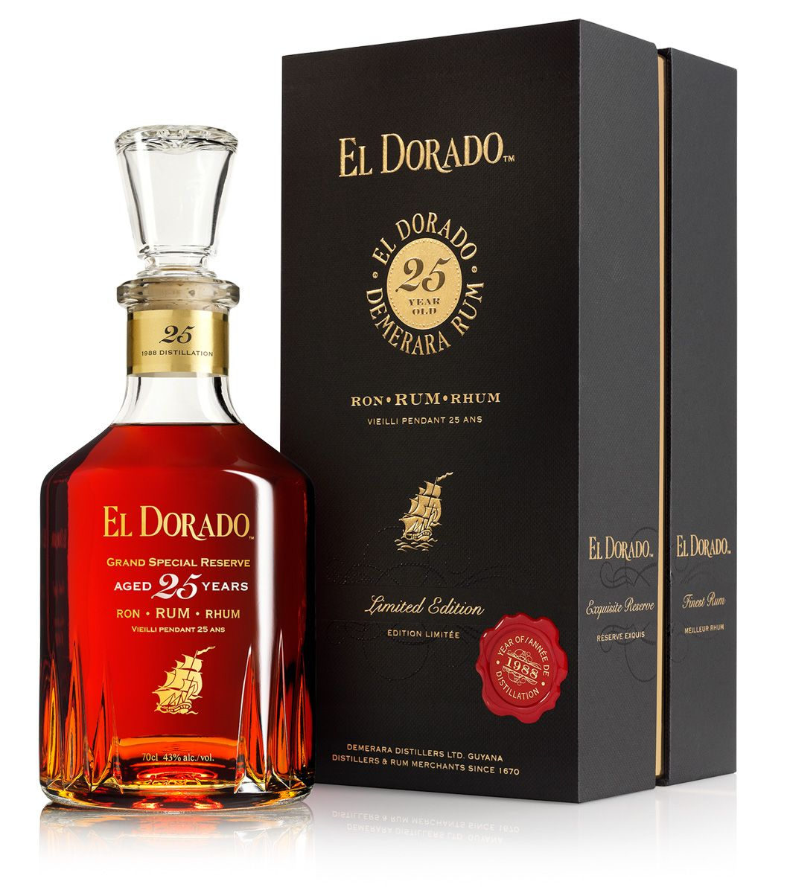
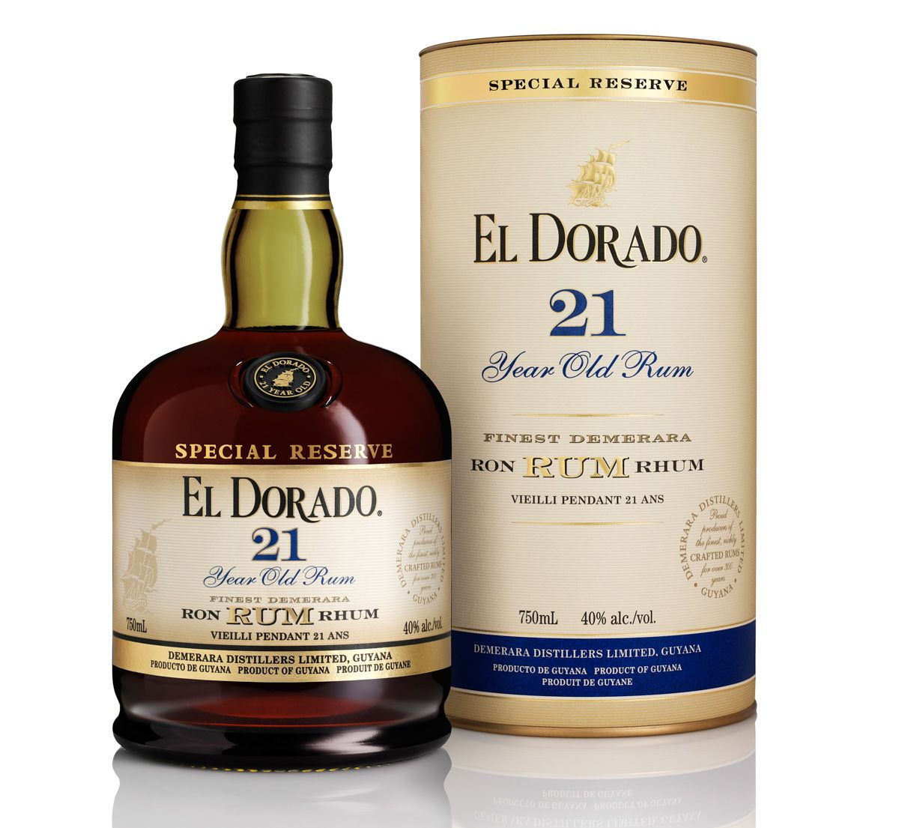
3. Promoting Export Competitiveness through GIs
Demerara Rum, Demerara Sugar and Demerara Molasses are registered protected geographical indications in Guyana.
There has been notable advancement in the utilisation GI as a tool for increasing the export competitiveness of Demerara Rum. Efforts are underway to better capitalise of GI registration for sugar and molasses.
Demerara Rum is commercialised under the brand of El Dorado Rum owned by Demerara Distillers Ltd.
The GI name is prominently displayed on the labels of DDL products.
Demerara Rum has strong brand equity.
Efforts are currently underway for registration of Demerara Rum in EU.

Slide 12
3. Promoting Export Competitiveness through GIs
Top ten markets for Demerara Rum account for 95% of Guyana’s exports (HS 220840). These are: United Kingdom, Canada, Netherlands, United States of America, Mexico, Germany, Trinidad and Tobago, Barbados, Bermuda and Dominica.
Between 2014 and 2018 there was an increase of 17% in the value of Demerara Rum exports totalling $ 48,686,000 (USD). There were significant increases in the value exports to the UK, Canada, USA and Netherlands.
Premium value is recognized through price and the competitive advantage of the product in the marketplace, especially in Europe.
Widespread brand recognition.
Moving up the value chain from commodity to high quality products. Decrease in exports of bulk rum and increase in exports of bottled rum. 15 rums with prices ranging from € 26 to €3333.
GI Certification contributes to quality assurance and internal control of production.
Codifies and protect the benefits of the Demerara provenance for rum production.
Apropos in the era of demand by consumers for product knowledge on social and environmental dimensions of the production process.

Slide 13
4. Integration of GIs into Market Access Strategies
At a market level:
GI product’s differentiation characteristics/features to be used to increase sales in the EU (identify those features that could make the product from Guyana unique relative to existing competitors on the EU market and that could make a difference when accessing EU trade channels or in counteracting competition on the EU market).
Sales strategy of the GI product in the EU:
Identify distributors;
Identify the specific market niches or trade channels that would be best used to market the GI product in the EU;
Communication and promotional strategy to follow to market the GI product in the EU;
Sales promotion (provision of relevant promotional information to key partners; customers’ visits and media-promotions, trade-fairs, etc.);

Slide 14
4. Integration of GIs into Market Access Strategies
Protection and branding strategy of the GI product:
Protection of the GI in the EU
Labelling and branding requirements
Other issues
At an economic and social level (use of a GI as a marketing and development tool):
Possible impact for stakeholders (producers / traders /exporters).
Possible impact for consumers: Impact on EU consumers, especially in terms of products perception/appreciation and quantities purchased; EU consumers’ willingness to pay more for the GI product.
Other impacts (economic, social and others - environmental, cultural, etc.)

Slide 15
5. Capacity Building requirements for strengthening competitiveness
Research on products, for e.g. Pomeroon Coffee limited scientific information on and absence of collective association.
Guidance on creation of associative structures to function as GI Management Body, for e.g. Hosororo Cocoa – group of loosely organised indigenous women with no systems in place for traceability and control.
Preparation guidelines and code of practice for producers, for e.g. Cassava Casareep.
Continuous awareness activities for producers and consumers to build understanding of GIs.
Review of 2005 legislation to strengthen systems of the GI: quality compliance, traceability, controls, penalties, promotion, protection
Strong market partners: promotion
Continuous training of staff of Control Authority to monitor for compliance and increase product conformity.

Slide 16
6. Conclusion
CARIFORUM countries have embarked on course towards the full recognition and protection of GIs.
For Guyana many of the potential GIs are located in remote indigenous communities with strong social, economic and environmental linkages.
Through GI recognition and protection these communities can receive fair value for their products and access to niche markets.
Efforts are ongoing to raise awareness of GIs and build the capacity of regulatory agencies to effectively execute their monitoring and control duties.
For a largely commodity exporting country, GIs can add value to products and secure their quality reputation.
NOT A MAGIC FORMULA - always depends on stakeholders’ capability to develop further the GI through promotion, awareness raising, market strategies to target niche markets, enforcement of their protection and commitment to the process.

Slide 17
THANK YOU VERY MUCH
FOR YOUR KIND ATTENTION
Lidon Charles
Project Coordinator / Foreign Service Officer III
EU Project “P041 - Support for the development of a Trade Export Strategy for SVG
and a GI Certification Scheme for Quality Exports in Guyana”

